Slide 1


Team Advantage
Good Collaboration and Communication
Anqi Liao | Leadership
Ye Liu | Flexibility
Mingkai Lu | Creativity
Jiale Yu | Adaptability
Dongdong Lai | Resource
Adaptability and Flexibility
Creativity
Resources and Network

Slide 2

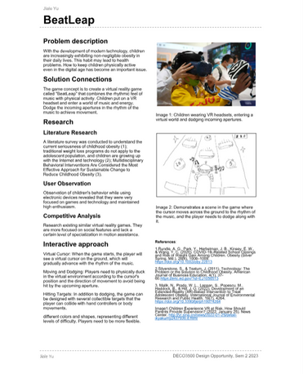
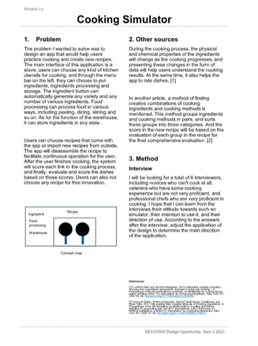
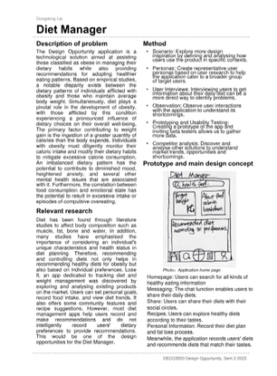
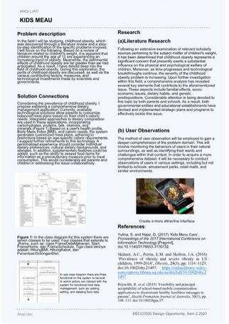
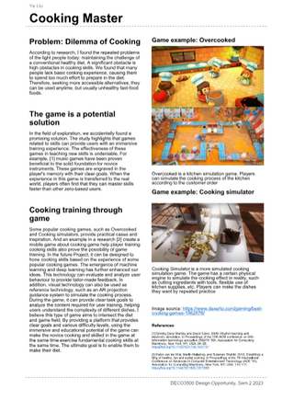
Domain: Understanding our Health
1.
understanding our health
Overweight Australian adults
2.
Obesity trends in Australian adults (no date) Obesity Evidence Hub. Available at: https://www.obesityevidencehub.org.au/collections/trends/adults-australia (Accessed: 30 August 2023).
National Health Survey: First Results, 2017-18 financial year (no date) Australian Bureau of Statistics. Available at: https://www.abs.gov.au/statistics/health/health-conditions-and-risks/national-health-survey-first-results/latest-release (Accessed: 30 August 2023).
(No date) Researchrepository.rmit.edu.au. Available at: https://researchrepository.rmit.edu.au/esploro/outputs/journalArticle/Improving-the-health-of-male-blue/9921862033401341 (Accessed: 30 August 2023).
blue - collar worker

Slide 3
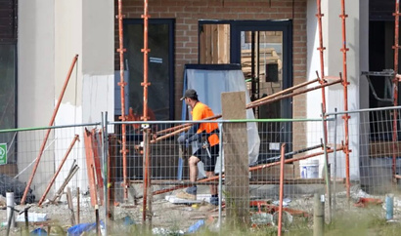
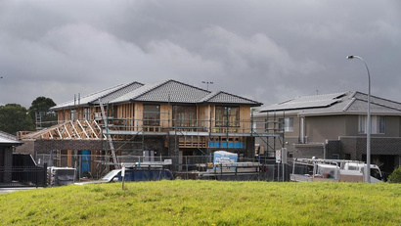
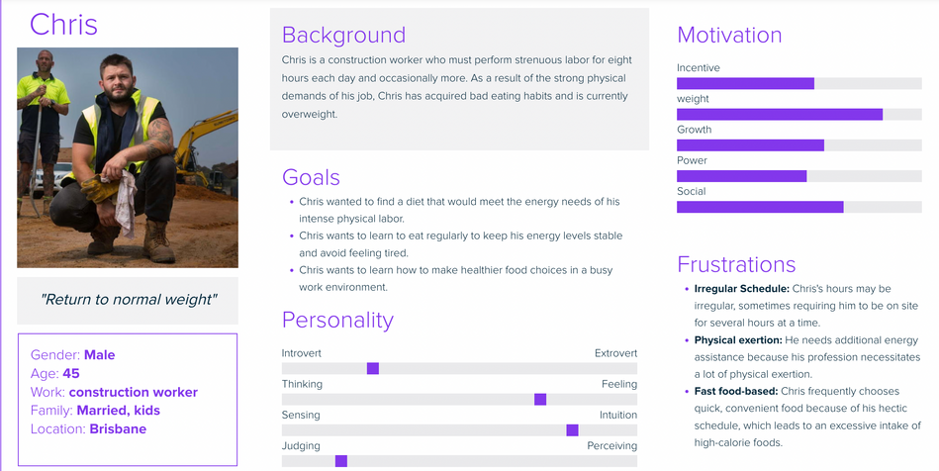
Audience & Design Opportunity
Observation
Persona
Questionnaire
55% Mainly fast food
37% don't understand healthy food combinations
65% above normal weight
Literature Research
25% often skip breakfast
65% Consistent drinking and smoking
Design opportunities
Provides advice on adapting to blue-collar diets
Provides the nutritional structure of food and related data
A platform for users to communicate and share dietary advice
Descriptive
(blue-collar)
Lack of positive eating habits.
Engaged in intensive physical labor
Overweight
One in Four Blue Collar Workers Regularly Skip Breakfast. (2014, March 10). The Courier Mail. https://www.couriermail.com.au/news/queensland/bundaberg/one-in-four-blue-collar-workers-regularly-skip-breakfast/news-story/a5e9d07f25478b156cc23f8040ae31cd
Marc a w damen. (2023, June 28). Factors Associated with Blue-Collar Workers’ Participation in Worksite Health Promotion Programs: A Scoping Literature Review. Health Promotion International. https://academic.oup.com/heapro/article/38/3/daad052/7209682
Notes:
我们通过观察，问卷和文献研究来深入了解目标人群的具体情况和目前面临的问题。
We used observations, questionnaires and literature research to gain insight into the specifics of the target population and the problems they are currently facing.
观察的地点选择了一个在施工中的房屋，我们发现建筑工人们在不间断的从事高强度的体力活动，并且很少休息。
The location of our observation was at a house under construction. We found workers engaged in intense physical activity without interruption and with few breaks.
我们利用问卷采访了7位卡车司机，10位厨师以及8水电工，问卷的目的是了解他们包括饮食习惯和体重情况。我们发现64%的受访者以快餐食品为主，其中37%不了解健康饮食搭配方面的知识。65%的人认为自己是超重的。
In addition, we utilized a questionnaire to learn about 7 truck drivers, 10 chefs, and 8 plumbers to understanding their eating habits and weight. We found that 64% of the respondents consumed mainly fast food, 37% of them dont know about dietary combinations, and 55% considered themselves to be overweight.
我们还查阅了最近的新闻和文献，研究发现超过25%的蓝领没有吃早餐的习惯，且由于工作压力太大，大部分人有持续喝酒和抽烟的习惯。
We also reviewed news and literature, which found that more than 25% of blue-collar workers do not eat breakfast, and most have a habit of continuous drinking and smoking due to work stress.
通过以上的调查，我们发现大部分目标人群的健康意识较为薄弱，从而养成了消极的生活习惯，增加了超重和肥胖的风险。
Through the above survey, we found that most of people has a weak health awareness, which leads to negative lifestyle habits and increases the risk of overweight and obesity.
因此，我们的目标人群是蓝领，他们普遍缺乏积极的饮食习惯，并且从事长时间体力劳动，并且面临超重的风险。
Therefore, our target users are blue-collar who generally lacks active eating habits and works long hours of physical labor and is at risk of being overweight.
因此，我们建立了一个Persona来代表了一个典型的用户群体，为我们未来的设计提供支持。
we also created a Persona to represent a typical user group to support our future design.
设计的机会包括为用户提供饮食建议和规划，帮助用户建立正确的饮食观念以及了解肥胖带来的危害。我们利用AI分析用户现有的饮食习惯，并通过大数据为用户提供适合的饮食结构，包含食品名字购买途径等。
The first design opportunity is to provide users with dietary advice and planning to help them establish a correct dietary concept and understand the hazards associated with obesity.
We can use AI to analyze the user's existing dietary habits and use big data to provide the user with a suitable dietary structure that includes food name purchase paths.
第二个设计机会，利用技术扫描食物的成分，用户可以清晰的了解到消耗的卡路里和营养结构，为用户饮食提供明确的帮助。
这可能会涉及到图像扫描和分析技术。这个概念参考了google识图功能。
The second design opportunity is to utilize technology to scan the composition of food ;users can have a clear understanding of the calories consumed and the nutritional structure, to provid a clear help for their diet.
This may involve image scanning and analysis techniques. This concept references the google literacy feature.
另一个设计机会是建立一个沟通和互助的平台。用户可以在平台分享彼此的饮食习惯和经验，利用社群的力量提升彼此的健康知识，建立良好的饮食习惯。
Another design opportunity is to establish a platform for communication and mutual support. Users can share their dietary habits and experiences, utilizing the power of community to enhance their health knowledge and establish good eating habits.

Slide 4

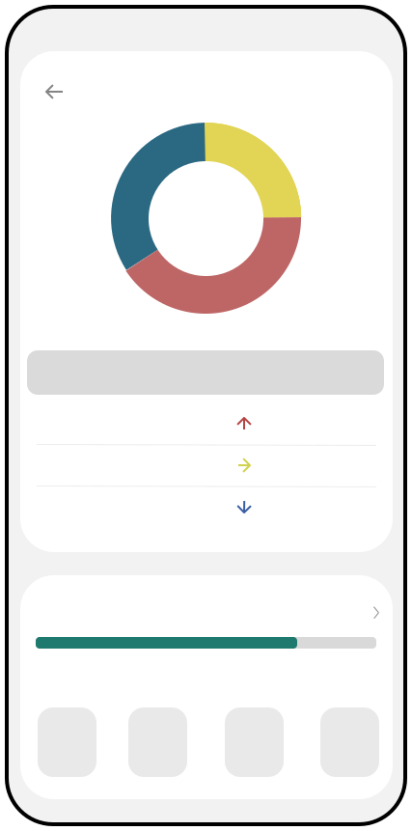







Design concept & Exiting technology
Prototype
Design concept
Record the nutrition of each meal
Monitoring eating habits Give users feedback by recording their daily eating habits | Analysing the nutritional structure Analysing the nutritional profile of the user's daily diet based on their daily recorded diets
Knowledge of nutritional intake Provide them with nutritional intake knowledge to raise awareness of nutritional intake standards among the target population. | Managing diet and physical health Finally, the analysed nutritional profile of the diet is used to develop a diet plan for them.
Nutrient Ratio
Breakfast
Dinner
Calorific Ratio
Lunch
Intake
459
586
177
Analysing the nutritional structure
recommended
327-430
480-600
190-220
Breakfast(Kcal)
Lunch(Kcal) Dinner(Kcal)
Exiting technology
Managing diets and recommending healthy eating plans
Food Type
ranking
Noom
MyFitnessPal
Lose It!
Today's Ingredients 9/12
meats
Graineggs
beans
2/3 1/4
This app that combines psychology and nutrition to help users develop healthy eating and lifestyle habits. It offers personalised guidance, progress tracking and supportive social interaction.
This is a very popular app that contains a large food database and allows users to track their diet and exercise. Users can set their own goals and customise their diet plans to suit their needs.
This app creates a customised weight loss plan for users by analysing their age, gender, height, current weight and target weight. It also allows users to track their diet and exercise.
Vegetable
Milk product
5/4
1/1

Slide 5


Future work Plan
What’s we need to do until next step
Week 6
Research and questionaire preparation
Stage 1
Stage 2
Understand the exists
problem
Research and investigation base on the problem
Empthatize
Week 7
gerenrating idea from results
and start project design
Problem define
Project
Design process
Test
Week 8
Complete first Prototype
Stage 5
Ideate
Do user test and get feedback
from blue collar worker
Stage 3
generating solution idea
Prototype
Week 9 Presentation material and Feedback analysis
Stage 4
Follow a schedule of
budgeting and stick to it

